Slide 1
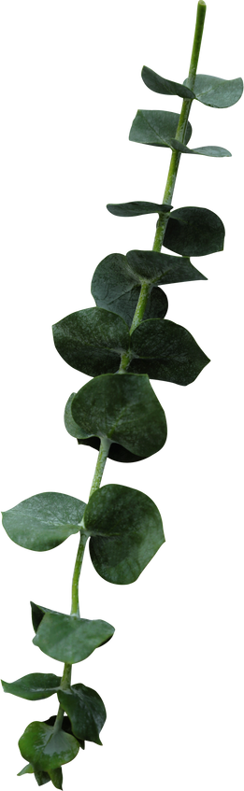
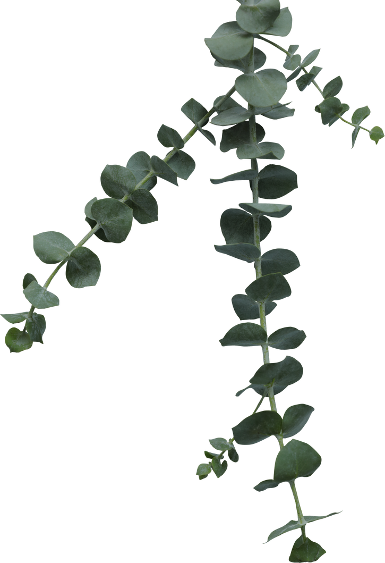

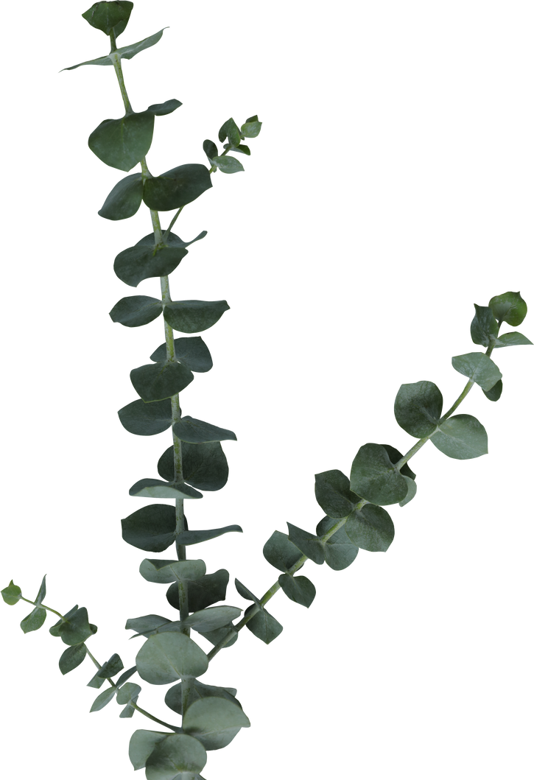
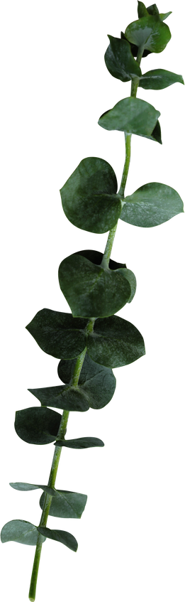
National Institute of Technical Teachers Training and Research Chandigarh
Credit card Fraud Detection &
Parkinson Disease Detection Model

Slide 2

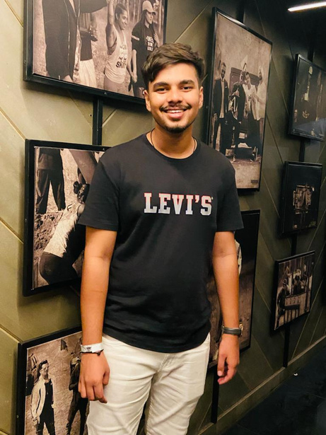
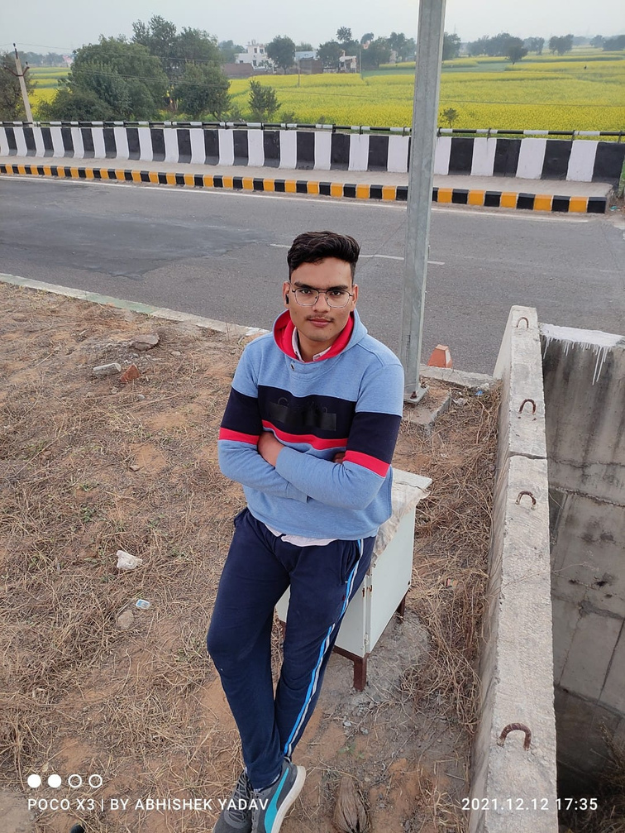
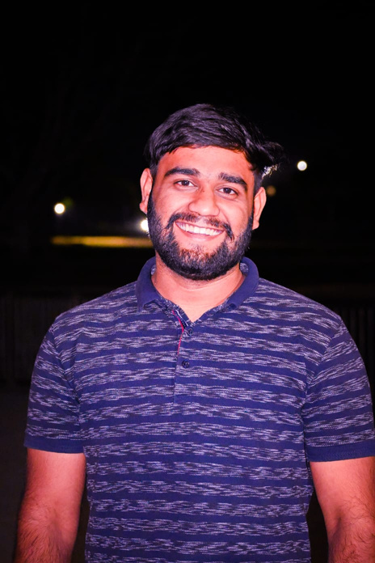
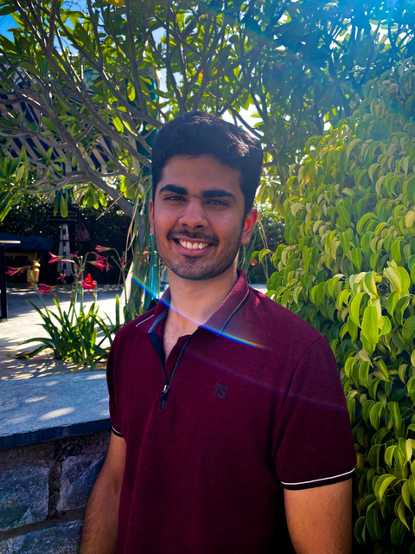
Meet
Our
Group
SHIVAM
ABHISHEK
GOURAV
ARYAN

Slide 3
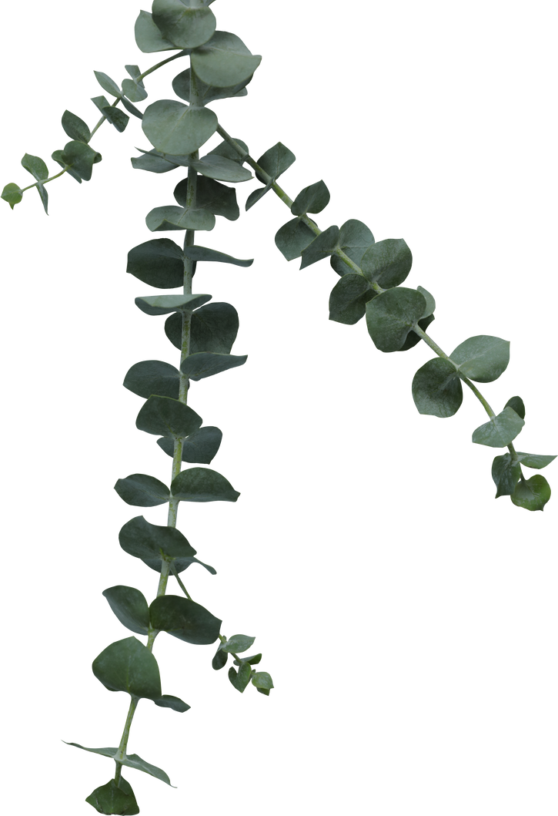



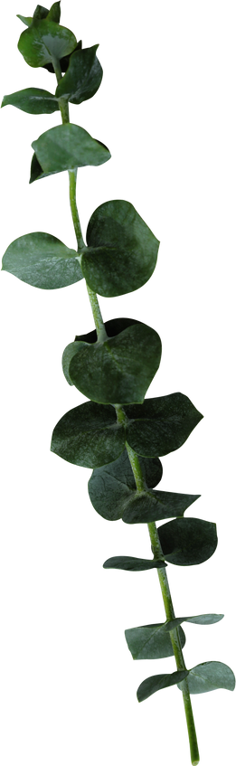
OBJECTIVES
ACCURACY PREDICTION
PREPROCESSING
MODEL TRANING
We converted unstructured data into well-formed data sets during data preprocessing so that ML algorithms could be used.
Through this procedure, we gave the machine learning algorithms sufficient training data to understand and predict the outcome.
When classifying data, we use accuracy as a statistic to indicate how often the predictions were correct.

Slide 4
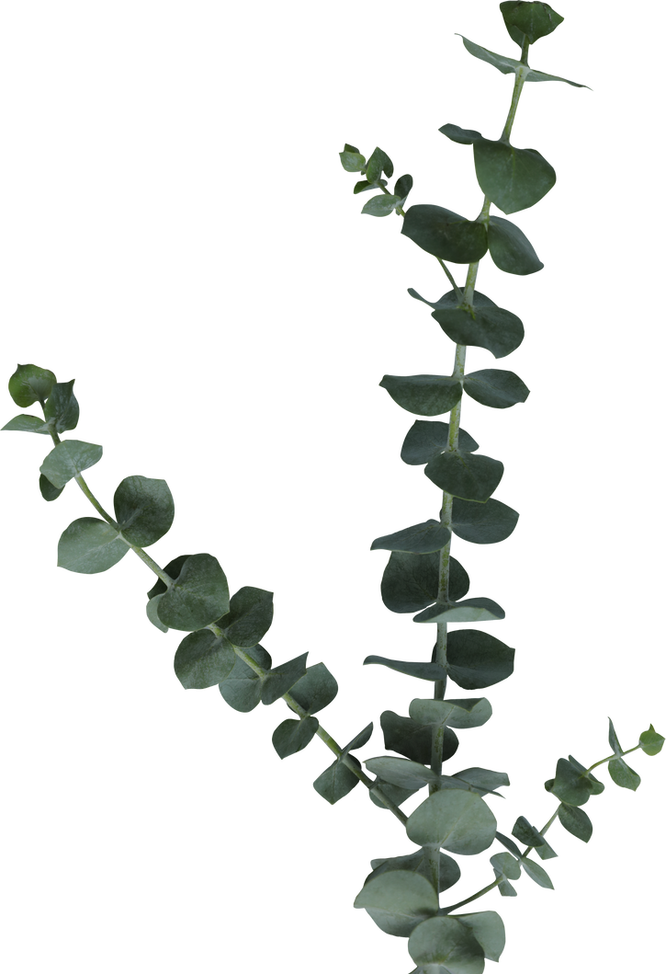



SOFTWARE USED
JUPYTER
GOOGLE COLAB
SPYDER
We use the free and open-source Jupyter Notebook web tool to create and share documents with live code, equations, visualizations, and text.
Colab is a product of Google Research. Colab is especially useful for machine learning and data analysis since it enables anyone to develop and run arbitrary Python code through the browser.
Spyder is an open-source cross-platform integrated development environment (IDE) for scientific programming in the Python language.

Slide 5
ROLES OF TEAM MEMBERS

Slide 6
FIRST SUBDIVISION
-Data collection
SECOND SUBDIVISION
-Data Preprocessing
PROJECT SUBDIVISION
THIRD SUBDIVISION
-Graph Plotting
FOURTH SUBDIVISION
-Model Training

Slide 7
Data collection
-Shivam
The process of gathering and monitoring data is known as data collection. I looked for the dataset on many websites, examined it carefully, and tried to learn more about it to determine whether or not it was the ideal choice for our project. Ultimately, I chose to work with a dataset from Kaggle.

Slide 8
CREDIT CARD FRAUD DETECTION
Dataset link :- https://www.kaggle.com/datasets/mlg-ulb/creditcardfraud
Notebook link :- https://colab.research.google.com/drive/1Py-0v51rVvokBCxDDTVyWM1F7MFvF07a?usp=sharing

Slide 9
PARKINSON DISEASE DETECTION
Dataset Link:- https://www.kaggle.com/datasets/debasisdotcom/parkinson-disease-detection
Notebook Link:- https://colab.research.google.com/drive/14WklZ1Oh1PvxlQq_Yhd270gnTuJGfaD_?usp=sharing

Slide 10
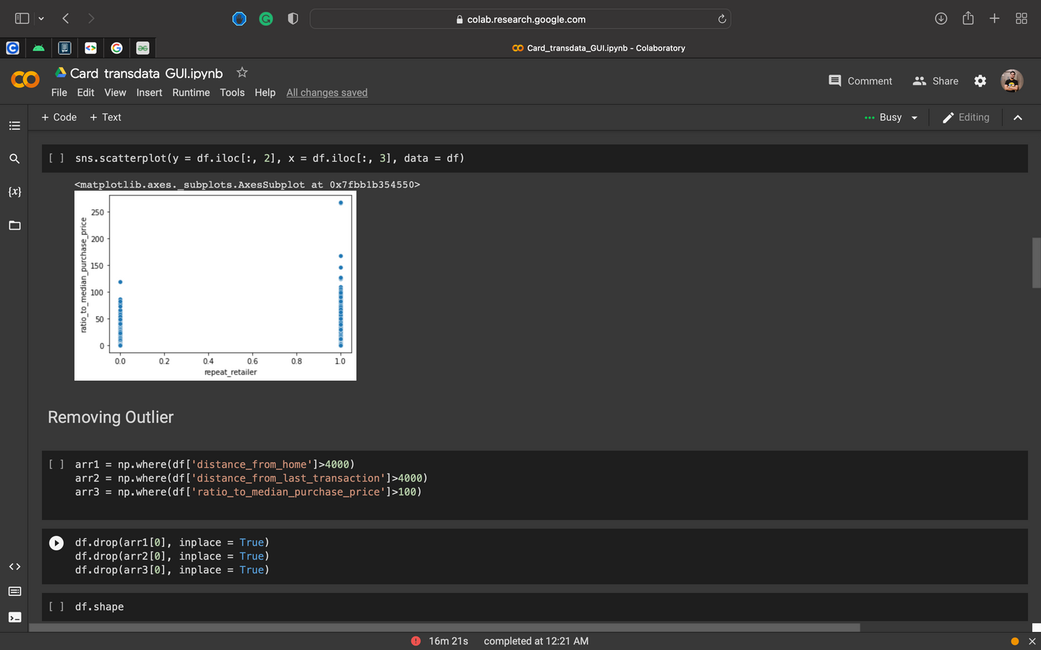
DATA PREPROCESSING
-GOURAV
First, I reviewed the data to see whether there were any null values in it. Next, I looked for outliers and deleted them. I also removed any unnecessary columns and reduced some of the columns by merging their data into a single column to reduce the dataset's load.

Slide 11
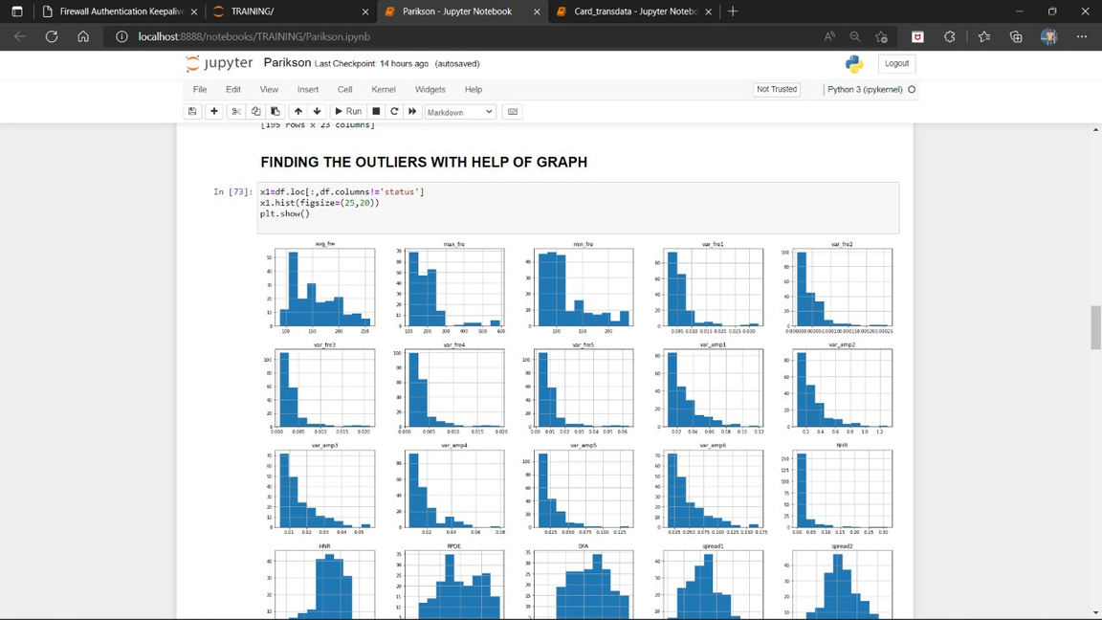
GRAPH PLOTTING
-ABHISHEK
Here, I made some graphs to represent the data set visually. To find changes in the data, I used scatter plots and heat maps. I plotted the graphs using libraries like seaborn and matplotlib.

Slide 12
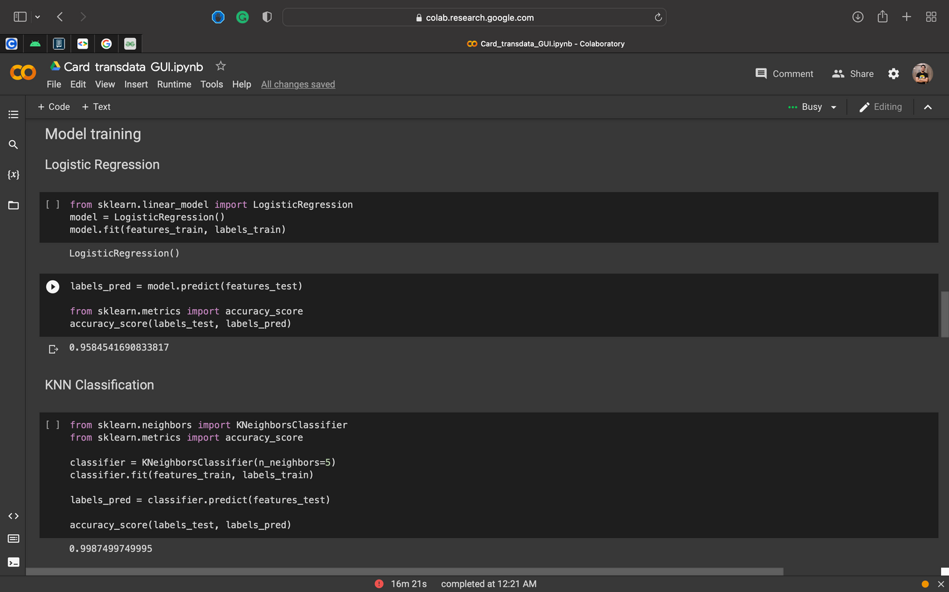
MODEL TRAINING
-ARYAN
Here, I divided the data into features and labels, split it using train test split, and then trained the data set using classification techniques like logistic regression, KNN, random forest, and other algorithms. I divided the data set in an 80:20 ratio, with 20% being test data and the remaining 80% being train data.

Slide 13
THANK YOU
SO MUCH!

